Slide 1
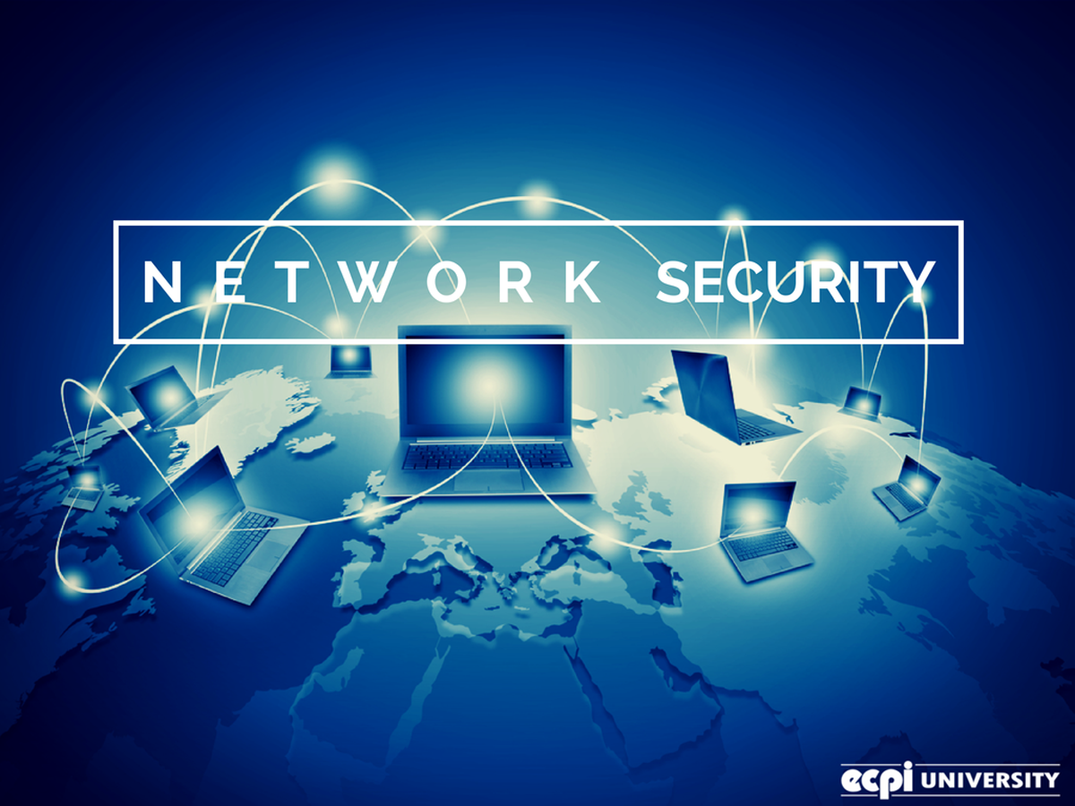
NETWORK SECURITY

Slide 2
The most common Wide Area Network is Internet –
It provides access to a worldwide network of computers with millions of users.

Slide 3
Networking offers endless possibilities and opportunities to every user of it
along with convenience.
It has become an inevitable part of our lives. Offering a mass amount of useful information, making communication easier and faster than ever, it presents some threats too along the way.

Slide 4

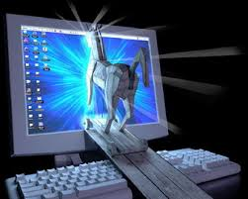

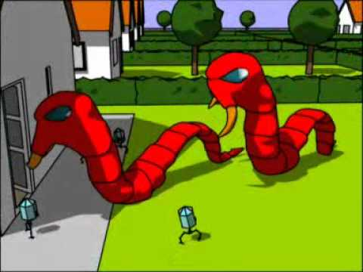

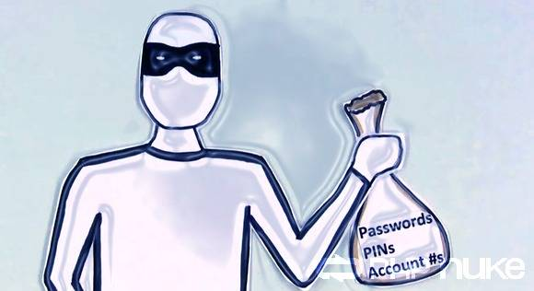

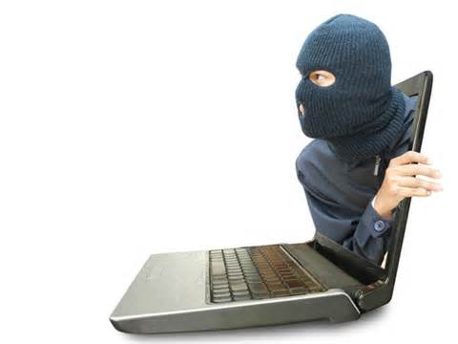
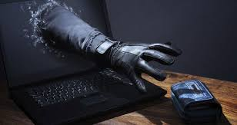
Can you Guess the threats ?
Trojan
Worms

Slide 5
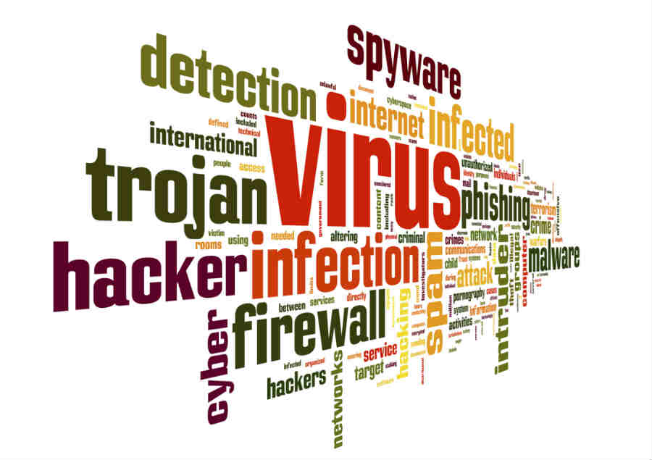

Slide 6
Why do people create Viruses ?

Slide 7
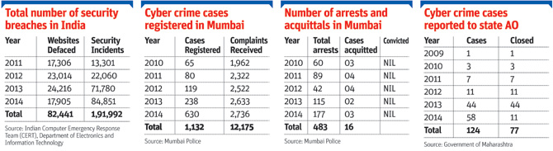

Slide 8
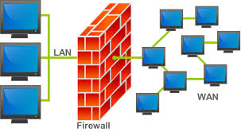
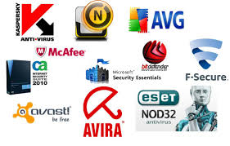
How to prevent network from these threats?
Use Firewall
Install Antivirus Software

Slide 9
Network security
  Allow authorized users access
  Prevent unauthorized users from obtaining acces
  Trade-off between security and performance

Slide 10
Firewall
  Protects local area network (LAN) from outside intruders
  Safety barrier for data flowing in and out
  Prohibits all data not allowed or permits all data not prohibited

Slide 11
Biometrics
  Uses unique personal information to identify
    Examples are fingerprints, eyeball iris scans or face scans

